Slide 1

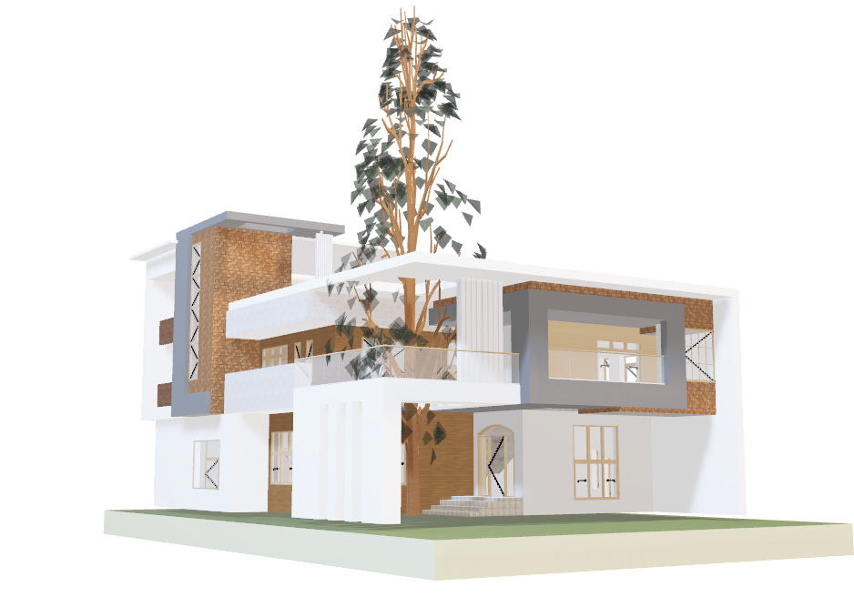
PropertyWorth
Easy solution to estimate your home prices
Group 1 - PropertyWorth
Notes:
Dibuka oleh fattah

Slide 2

Executive Summary
Property
Worth
Issue
Helping developers/individuals to determine the selling price of houses
There is no specific application to determine the selling price of a house in Jakarta
House price trends tend to increase from year to year, making it an obstacle for some people in determining the selling price of their house.
Question
How to determine the selling price of a house based on the specifications of the house?
Method/Model
Machine Learning Regressive Model
Determine the variables that influence house prices
Comparing several regression algorithms
Implement the best regression model
Impact
Provides easy house price predictions
Helping the home appraisal process
Notes:
Fattah

Slide 3
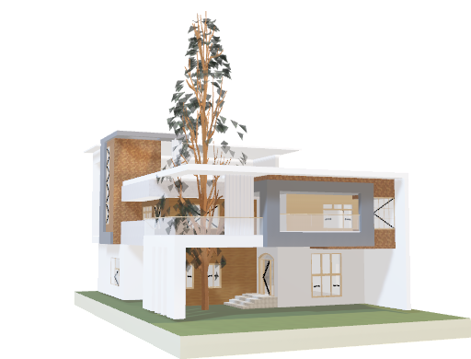
Process of Engineering Data
Property
Worth
Web Scraping
Data Cleaning
Saving
web scraping from the Lamudi.co.id website
The data obtained from web-scraping is carried out by a data cleaning process
when the data is clean enough, the clean data is then saved
Notes:
Fattah

Slide 4
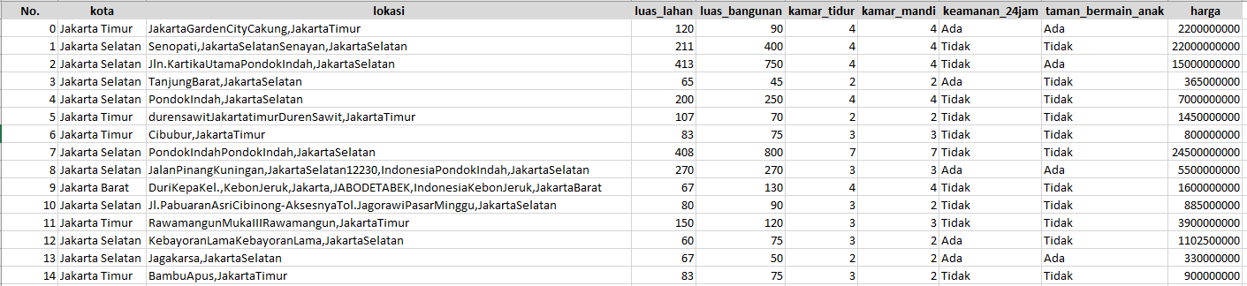
Overview Dataset
Property
Worth
Sources : https://www.lamudi.co.id/
Method : Scraping with Browser Extension
Have 10 column 2565 rows
Notes:
Fattah

Slide 5
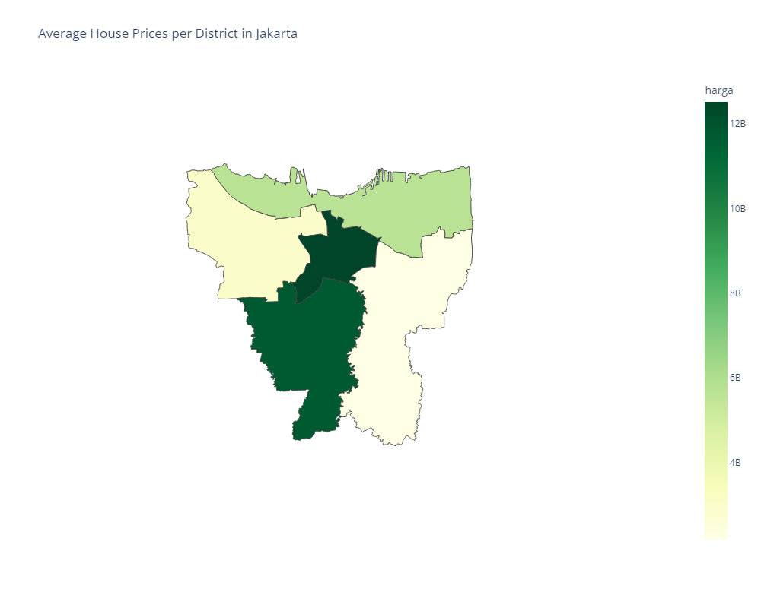
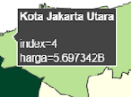

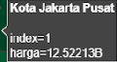
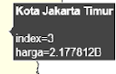
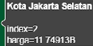
Property
Worth
Analysis Data
Differences in average house prices between 5 city areas in DKI Jakarta
Central Jakarta is the city with the highest average house price, around IDR 12.5 billion (near the government office and business centers)
South Jakarta is the city with the second highest average house price, around IDR 11.7 billion (near with many Central Business District)
North Jakarta is the city with the third highest average house price, around IDR 5.7 billion (near with port, beach and tourist place)
West and East Jakarta are cities with an average house price < IDR 3 billion
Notes:
Fahmi / Firhan

Slide 6
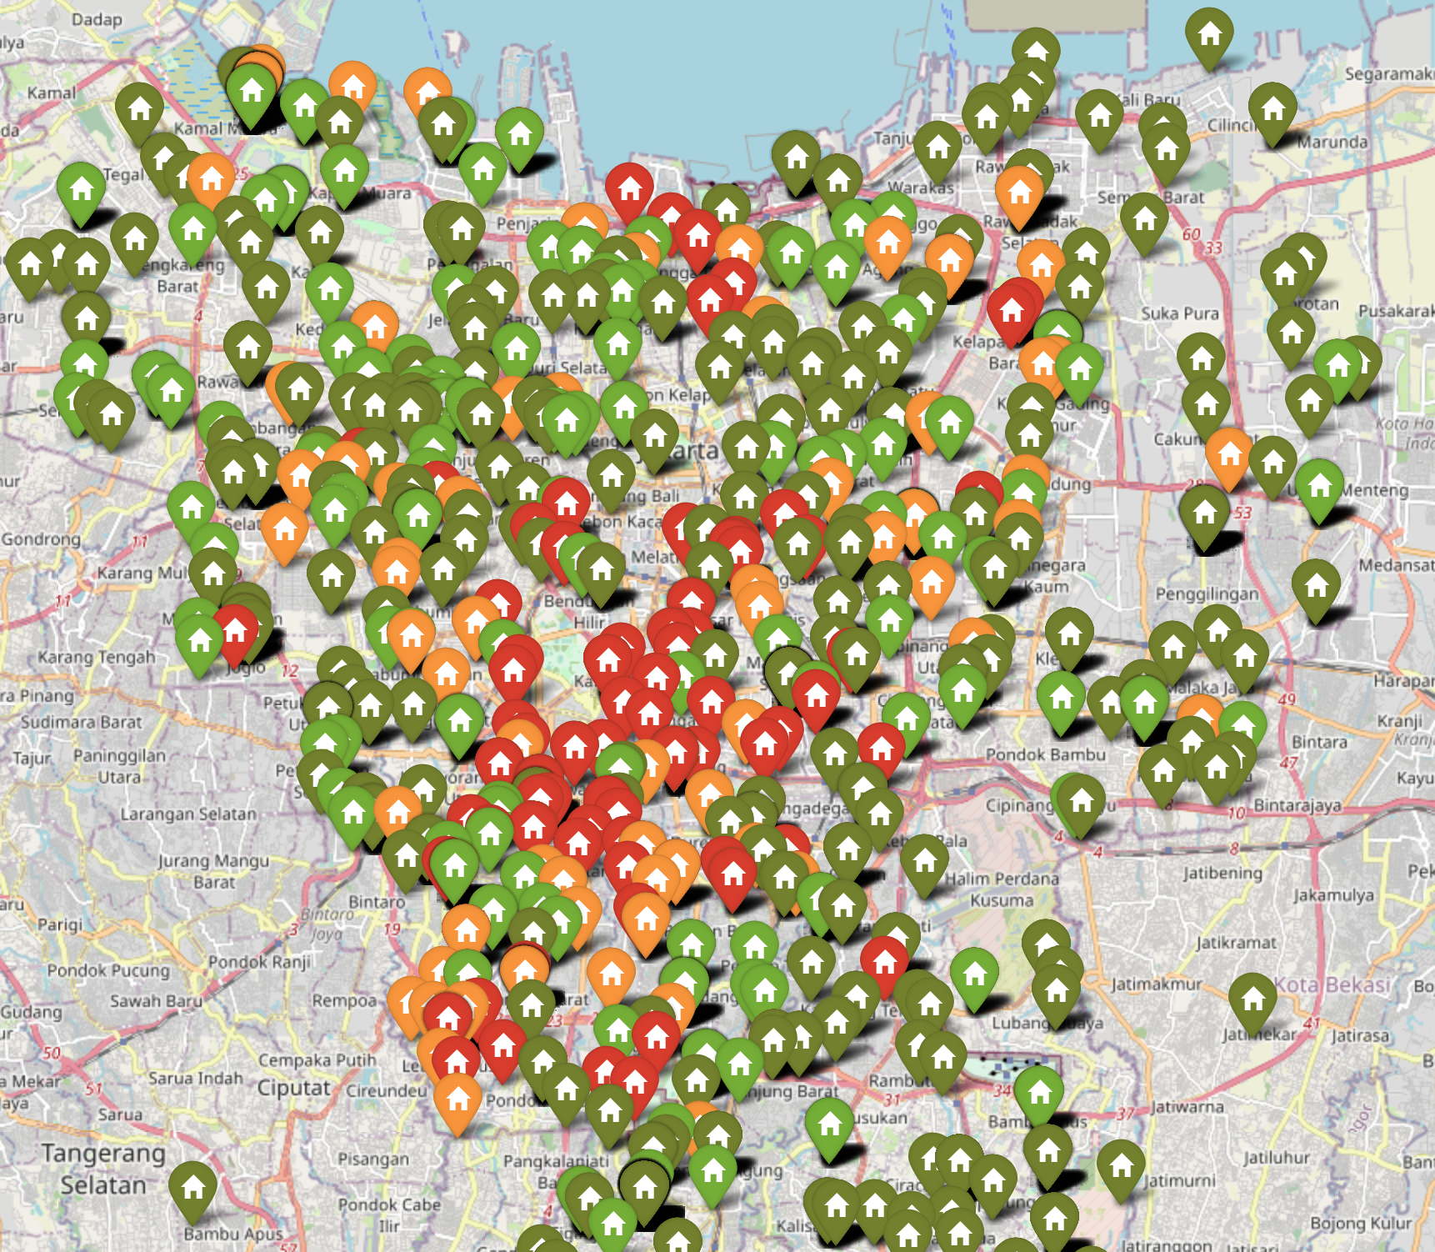
Property
Worth
Analysis Data
An overview of the distribution of houses and also their prices
A house with a red pin shows the price > IDR 10 Billion
Houses with orange pins show the price is IDR 5-10 Billion
The house with the light green pin shows the price is IDR 2.5 - 5 Billion
Houses with dark green pins show the price is < IDR 2.5 Billion
Notes:
Fahmi / Firhan

Slide 7
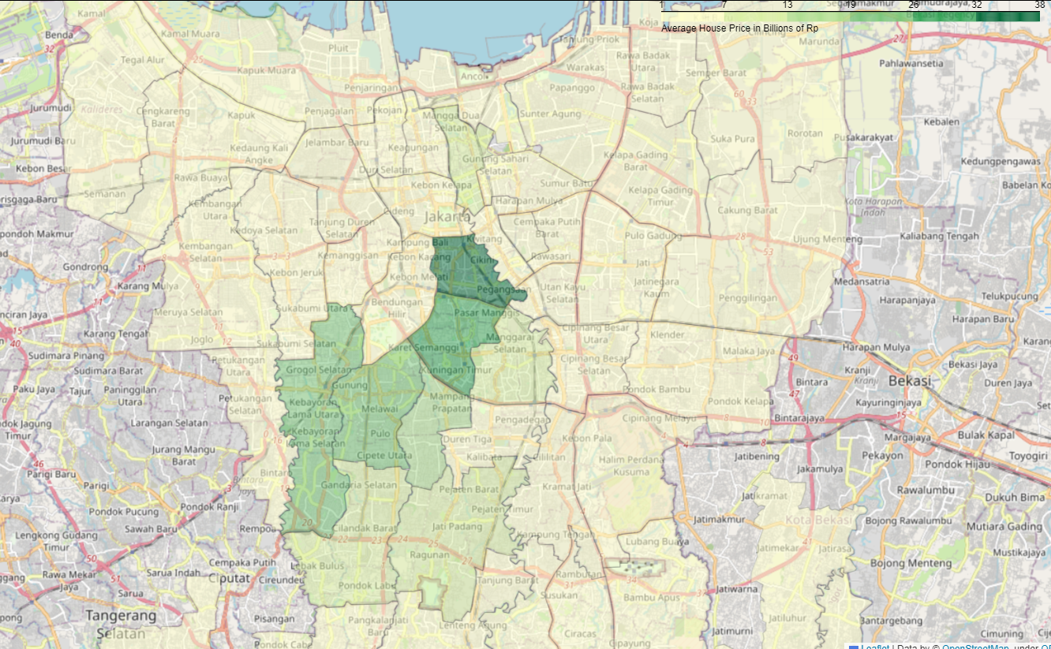
Property
Worth
Analysis Data
An overview of the distribution of houses and also their prices
Notes:
Fahmi / Firhan

Slide 8
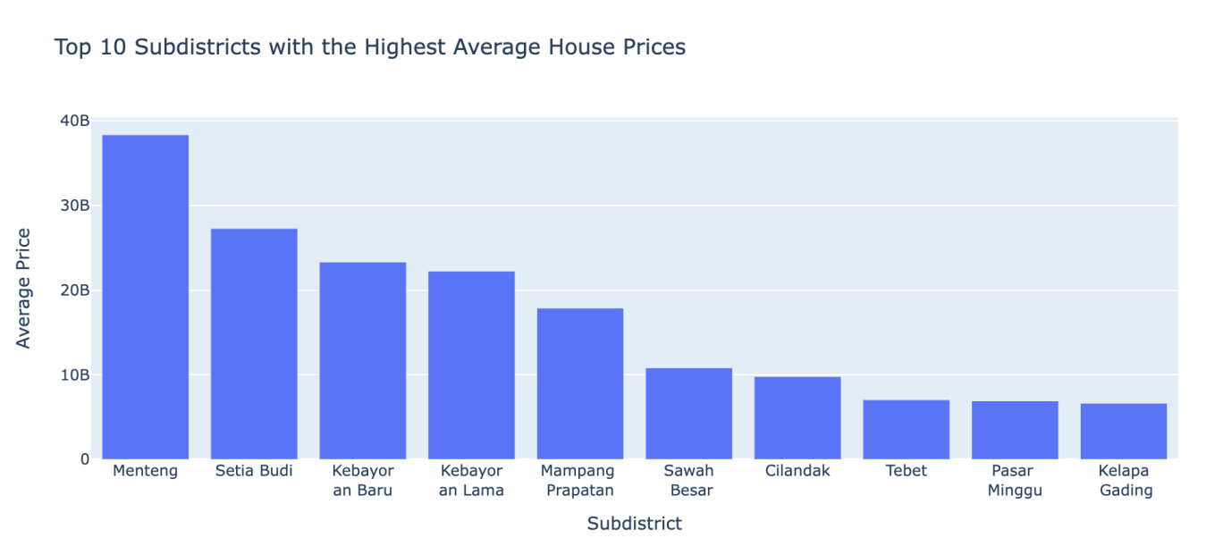
Property
Worth
Analysis Data
Menteng, which is one of the sub-districts in Central Jakarta, has an average house price of IDR 38.3 billion
Setiabudi, Kebayoran Baru, Kebayoran Lama have an average house price in the range of IDR 20 - 30 billion
Mampang Prapatan and Sawah Besar have average house prices in the range of IDR 10 - 20 billion
Other sub-districts have an average house price < IDR 10 billion
Notes:
Fahmi / Firhan

Slide 9
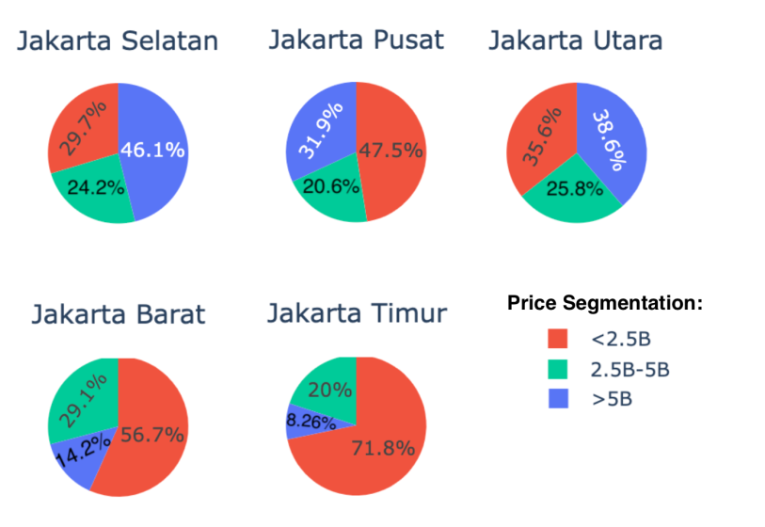
Property
Worth
Analysis Data
Percentage distribution of houses based on price range in each city in DKI Jakarta
There are many choices of houses with prices > IDR 5 Billion in the South Jakarta, North Jakarta and Central Jakarta areas
But, if you want to find a price < IDR 2.5 billion, the East Jakarta and West Jakarta areas could be an option
Houses priced at IDR 2.5-5 Billion are available in all areas of DKI Jakarta with a percentage of around 20-29% in each district
Notes:
Fahmi / Firhan

Slide 10
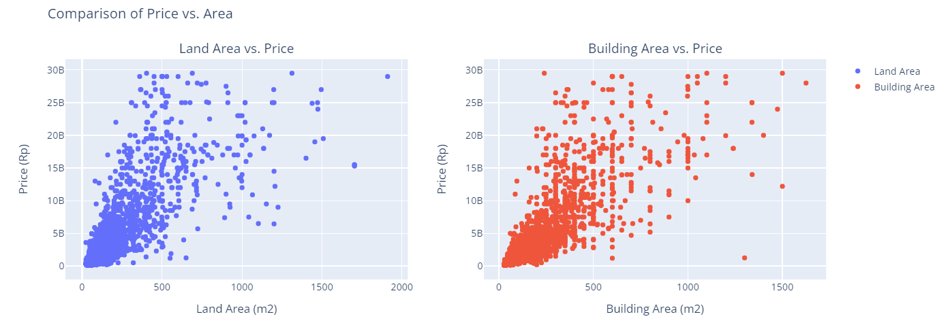
Property
Worth
Analysis Data
Comparison between Land Area vs Price and Building Area vs Price
There are many distribution data of houses with land area and building area < 500m2, the price is more at < IDR 10 Billion, but some are > IDR 10 Billion
Houses with land area and building area > 500m2 are few with a price < IDR 10 Billion and more have a price > IDR 10 Billion
Notes:
Fahmi / Firhan

Slide 11
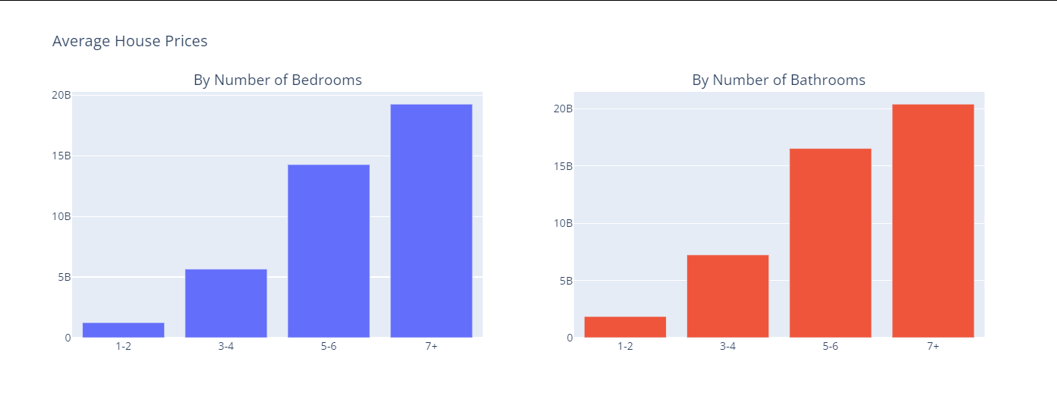
Property
Worth
Analysis Data
The influence of the number of rooms and number of bathrooms on house prices
Houses with < 3 bedrooms and bathrooms each have a price of < IDR 5 Billion
Houses with > 2 bedrooms and bathrooms each have a price > IDR 5 billion
The more bedrooms and bathrooms, the higher the price
Notes:
Fahmi / Firhan

Slide 12
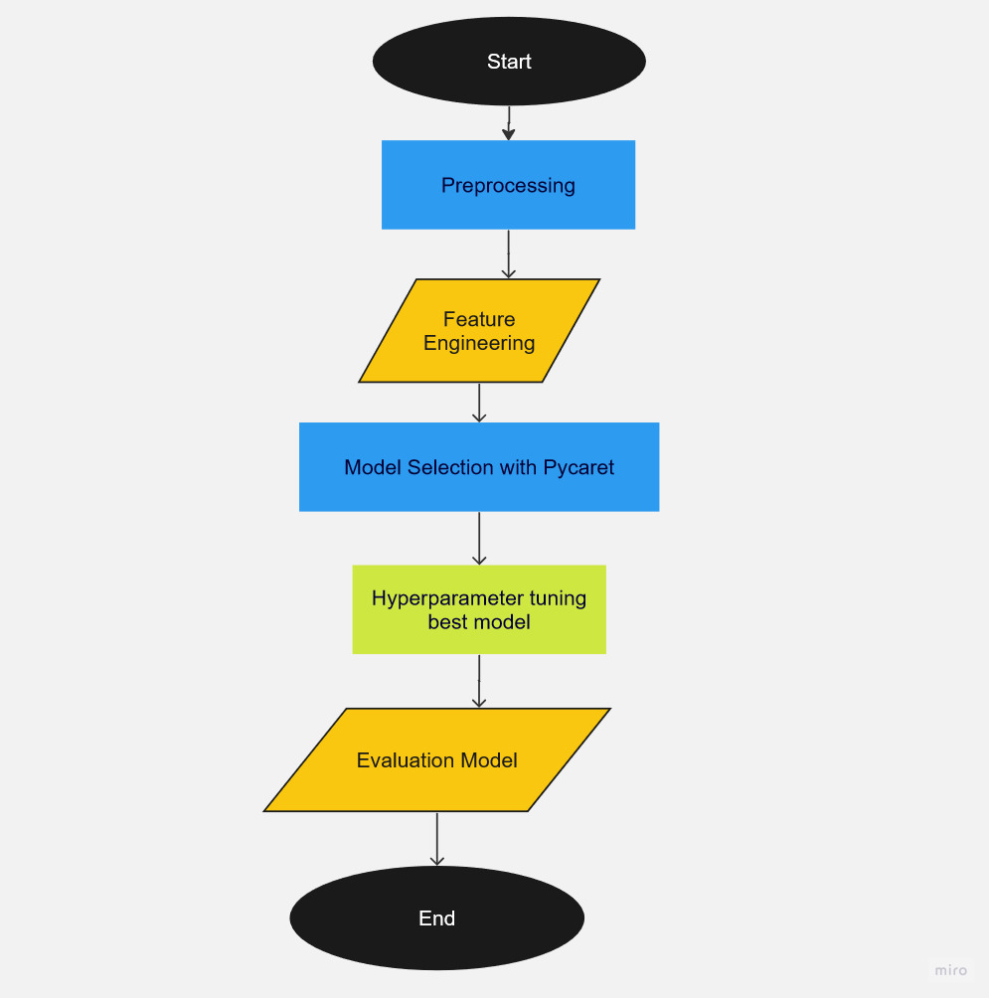
Property
Worth
Methodology
Notes:
Ghedi

Slide 13
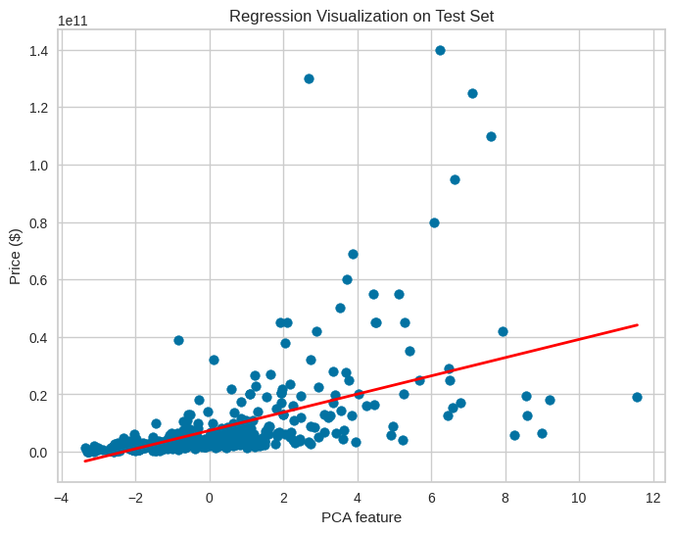
Property
Worth
Model Evaluation
Notes:
Ghedi

Slide 14
Property
Worth
Demo Model
Demo Model
(huggingface)

Slide 15

Property
Worth
Challenges
Insufficient data
Project work in short time
Limited PC Resources related to Geospatial Analysis

Slide 16


Property
Worth
Success Story
Successfully applied geospatial analysis, which had learn before.
Successfully implemented the pycaret library, to more efficient the modeling process.

Slide 17
Property
Worth
Conclusion & Business Impact
The objective has been achieved but further improvements are needed to accurately predict house selling prices.
Separating the dataset based on price range/city area so that each model can be created later.
Data scraping is more specific to certain agents who have a fixed commission rate so that house prices are more measurable.
Collect more data and other house specifications.
Scheduling the web-scraping process, ETL process, and Modeling process.

Slide 18




Property
Worth
Thank You
M Fattahillah
FTDS-RMT-022
Data Engineer
M Gheddi
FTDS-RMT-022
Data Scientist
Firhan
FTDS-RMT-022
Data Analyst
M Fahmi F
FTDS-RMT-022
Data Analyst
Hacktiv8id
Hacktiv8id
Hacktiv8
Hacktiv8 Indonesia

